Slide 1

Touchless muscle activity monitoring for Hand gesture recognition
1
Zijing Zhang,
PhD Candidate,
2019-Expected May 2023,
School of Electrical and Computer Engineering
Cornell University, Ithaca, NY
Notes:
Hello, welcome to my A exam. The topic of my presentation is ….

Slide 2
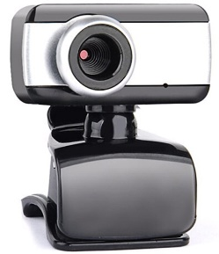
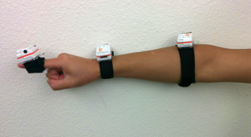
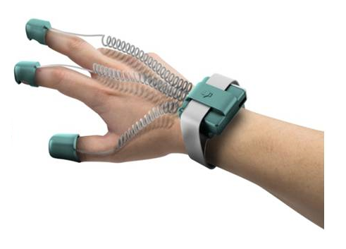
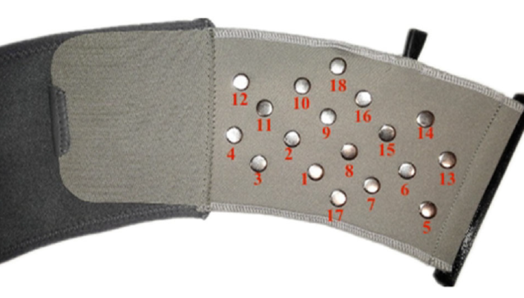
Existing hand gesture recognition systems
Camera-based?
Occlusion
Complex
Privacy
Latency
Motion-based?
Bulky on finger and hand
Only surface motion
Gloved-based?
Hinder hand motion
Inconvenient
Uncomfortable
sEMG-based?
Direct skin contact
Ambiguity
Numerous electrodes
Notes:
Hand gesture recognition (HGR) is a natural and effective way of human-computer interaction (HCI).
Camera based HCI though with high accuracy, requires off-body line-of-sight (LoS) cameras, vulnerable to obstruction from self and ambient. Invlove privacy issue, For dynamic motions, adequate time resolution would demand high frame rates.

Slide 3
RMG (radio-myography) for muscle activity sensing
Multiple-input multiple-output (MIMO)
near-field coherent sensing (NCS) radio sensor
continuous muscle actuation sensing that can be wearable and touchless, capturing both superficial and deep muscle groups.
Touchless
Notes:
From near-field EM coupling, NCS modulates the dielectric change of the internal muscle groups during hand gestures onto radio signals.
Advantages : 1.non-invasive, touchless 2. forearm, not hinder finger motions 3. couple deep muscle groups

Slide 4
Study protocol and data processing
8 participants 5,847 samples
23 gestures
23 hand gestures used in the study protocol
1D time series
To
2D spectrogram
STFT
CWT
data pre-processing
Each gesture is segmented into 5s time window

Slide 5
Classification results using deep learning
Overall accuracy=99.0%
personal training model
Model:
Vision transformer
7-fold CV

Slide 6
Classification results using deep learning
Overall accuracy=96.6%
Transfer learning on the unseen participant by 1/5 of new data.
Pre-train on
general model
Fine-tune by
few cases of
new participant
Model:
Vision transformer

Slide 7
Analysis on classification results
personal training model
Vision
Transformer outperformed
CNN
Ensemble
boosts
accuracy
(a)
(b)
Transfer learning for unseen users
(c)
(d)
Notes:
Attention mechanism enhances the important parts of the input data and fades out the rest. Long-term dependency.

Slide 8
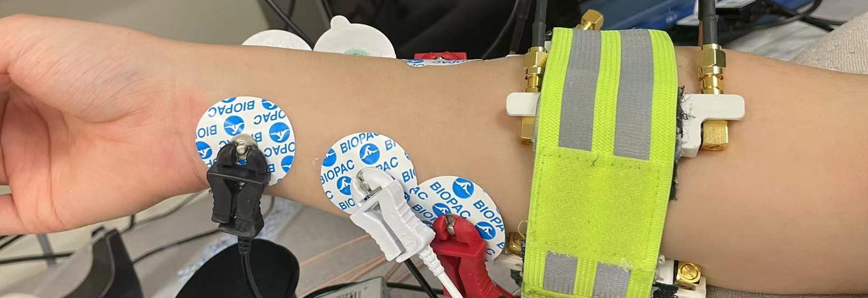
Benchmark with sEMG
sEMG
G
+
-
RMG and sEMG waveforms for various gestures by DTW averaging on all samples
Accuracy comparison
of RMG vs. sEMG
High temporal correlation
Consistent time lag
Exp: | 1 | 2 | 3 | µ
RMG | 99.0% | 98.5% | 98.7% | 98.7%
sEMG | 68.2% | 70.8% | 66.7% | 68.6%
Notes:
Conventional sEMG is the present gold standard in clinical applications for muscle activity detection and electro-diagnosis.
Compared peak location and pulse width
RMG and sEMG have a high temporal correlation and a consistent time lag. This delay may indicate the time offset between neural stimulation and muscle actuation.

Slide 9
Variation in experimental design
Timing and latency
Sampling rate:
Camera: 60 fps RMG: 1M sps
 | Timing Test
 | 150 beats/minute
 | µ | σ
RMG | 0.40 s | 38 ms
sEMG | 0.40 s | 55 ms
 | Notch (a) | Box (b) | Wrist (c)
Accuracy (%) | 99.0 | 97.4 | 95.8
Notes:
High time resolution with low latency is an important criterion for dynamic HGR.
For camera-based methods, the high time resolution demands high frame rates with increasing cost and heavy data loads,
Conclusion: RMG can capture gestures with high speed with ultra-low latency

Slide 10
Comparison of RMG to previous HGR works.
Notes:
Most of the existing HGR systems can only distinguish fewer than 10 hand gestures.
RMG outperform state-of-art HGR systems regarding gestures we can distinguish and accuracy we can achieve at the same time

Slide 11
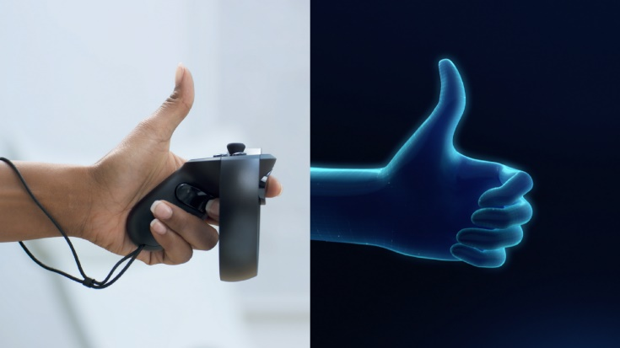
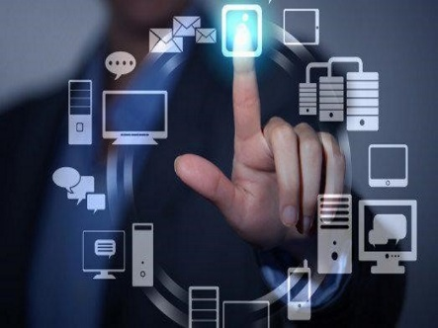
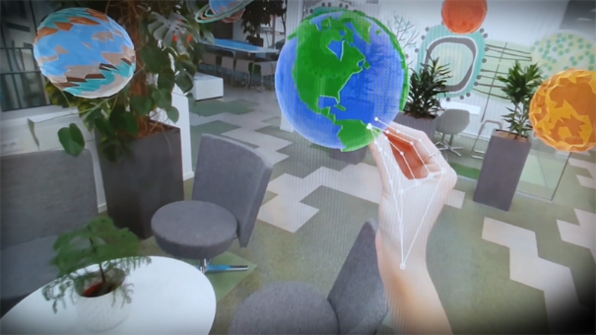
Applications in Human Machine Interface
Hand gesture recognition system
Smart device control
Virtual object manipulation
virtual reality gesture control
Notes:
facilitate human computer interaction3D virtual reality control; sign-language detection for disable people, assistive robotic control; non-contact navigation in smart cars .
Eye-movement and blink for gaze control

